Slide 1
Lecture 3 Wireless LAN (07/03)
1. Introduction
2. Wireless LAN Protocols | a. MACA; b. MACAW
3. Wireless communication protocol stack
4. MAC 802.11 Sublayer Protocol
5. CSMA/CA
6. The 802.11 Frame Structure
7. TCP Congestion Control
8. 802.11b MAC Protocol (Review)
9. TCP/UDP over 802.11b Wireless Networks
10. Appendix
11. Service
12. Conclusion
(Recommended: T. 68-71,134-137, 267-270, 292-310 208-211, 462-464, 553-555

Slide 2

802.11 Wireless LAN Configurations
1. Ad-Hoc Networking 2. Peer-to-peer Networking
BS
Standardized 802.11 (Wi-Fi="Wireless Fidelity”) (mid 1990) compatible with Ethernet above the DLL to send an IP packet over the WLAN.

Slide 3
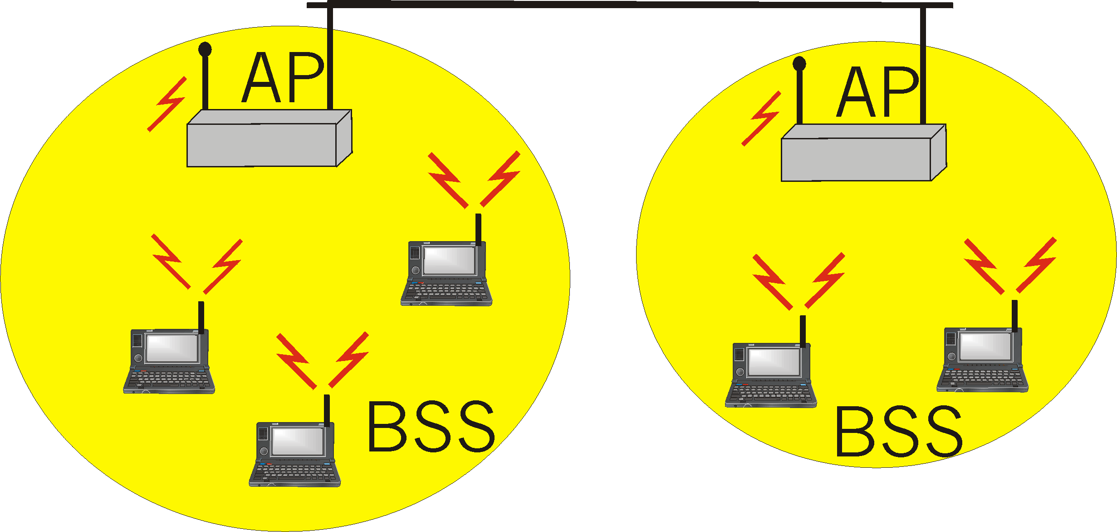
IEEE 802.11 Wireless LAN
Applications:
Internet access, portable connection, Ad Hoc networking (multi-hopping)
Unlicensed frequency spectrum bands: 900Mhz,
2.4 GHz -5.7 GHz
AP Like a bridged LAN
Portal connection

Slide 4
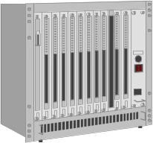

IEEE standard 802.11
fixed terminal
mobile terminal
server
infrastructure network
access point
(BS)
application
application
TCP
TCP
IP
IP
LLC
LLC
LLC
802.11 MAC
802.11 MAC
802.3 MAC
802.3 MAC
802.11 PHY
802.11 PHY
802.3 PHY
802.3 PHY
Each LAN cell has only one channel, Unlike cellular systems, covering the entire available bandwidth and covering all the stations in this cell. Typically, its Bit Rate is 11 to 54 Mbps.

Slide 5
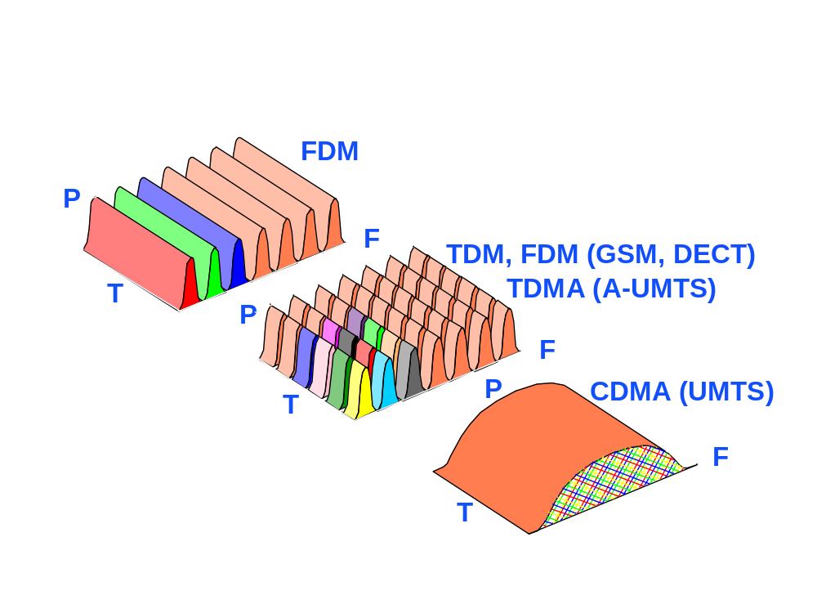

Slide 6
SDMA
c
c
t
t
Cells
f
f
c
Guard space
t
SDMA is always used in combination with one or more other schemes.
f

Slide 7
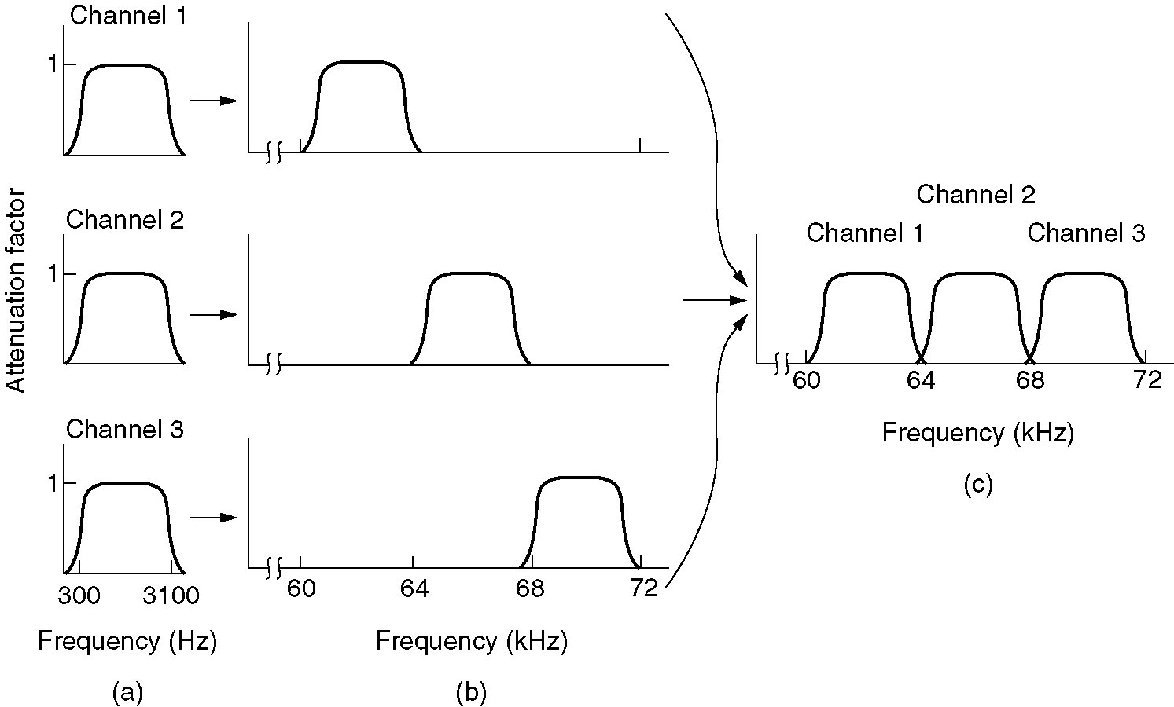
FDMA
(a) The original bandwidths.
(b) The bandwidths raised in frequency.
(b) The multiplexed channel.

Slide 8
Random Access protocols (Review)
Ethernet
A node transmits at random (no priority among nodes).
If “collide”, they retransmit at random times
The random access MAC protocol specifies how to detect collisions and how to recover from them (via delayed retransmissions, “binary back off”)
Random access MAC protocols:
(a) ALOHA
(b) SLOTTED ALOHA
(c) CSMA/CA and CSMA/CD

Slide 9
Aloha Multiple Access
Sender A
Sender B
Sender C
Sender A
Sender B
Sender C
Aloha
(18%)
ZigBee
Slotted
Aloha
(37%)
Collision

Slide 10
CSMA (Carrier Sense Multiple Access)
CSMA: listen before transmit. If channel is sensed busy, listens again. (Leonard Kleinrock, 1975).
Persistent CSMA: retry immediately when collide (this may cause instability. Note: collisions may still exist, since two stations may sense the channel idle at the same time)
Non persistent CSMA: retry after random interval
CDMA with Collision Avoidance (CA) access schemes used in wireless LANs. Here sensing the carrier combined with a back-off scheme. (MACA)

Slide 11
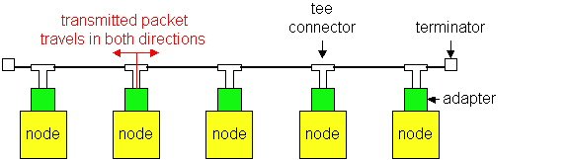
Ethernet Technologies: 10Base2
(IEEE 802.3)
10Mbps, under 200 meters max cable length
Thin coaxial cable in a bus topology
Ethernet operates with CSMA/CD protocol.
S/N =1000

Slide 12
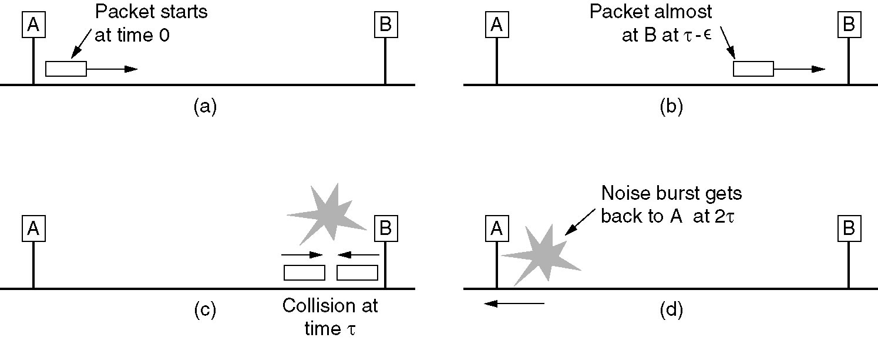
Limitations

Slide 13
Differences with Ethernet
Ethernet operates with CSMA/CD protocol.
With wireless LANs that idea does not work well.
1. Problems with multipath fading of a radio signal
2. Mobility of wireless communication stations.
3. Base station-to-base station movement.
4. Exposed and hidden stations problems
From the outside, the entire system should look like a single Ethernet.
S/N <<100, can not listen during a transmission
CSMA/CA

Slide 14
Wireless LAN Protocols
Possible interference at B
A
B
C
D
A
B
C
D
Radio range
a
b
Hidden station problem
Exposed station problem
Two Major Problems

Slide 15
The MACA protocol
C
A
RTS
B
D
C
A
CTS
B
D
E
E
A sending an RTS to B; B responding with a CTS to A. After CTS is received, A begins transmission
Anyone hearing RTS must remain silent until CTS to be transmitted back to A. Anyone hearing CTR must remain silent during the upcoming data transmission, whose t determined from CTS.
C is within of A, but not within of B. So, it hears RTS from A, but not CTS from B. Since it does not interfere with the CTS, it is free to transmit while the data frame is being sent.
D is within of B but not A. It does not hear RTS but hear CTS. Hearing CTS, it waits about to receive a frame, so it holds sending anything until that is expected to be finished. E hears both control messages and must be silent until the data frame is complete.

Slide 16
Medium Access with CSMA/CA
When many users are located in the same area, and use the same wireless LAN at the same time, two different access methods are defined for signal multiplexing:
1. Distributed Coordination Function (DCF)
1a. Physical channel sensing
1b. Virtual channel sensing
2. Point Coordination Function (PCF) (BS control cell)
The basic access mechanism, called the DCF, Two modes:
1a. & 1b Using CSMA/CA

Slide 17
Medium Access with CSMA/CA (Cont)
The basic access mechanism:
1. DCF = CSMA/CA algorithm = 2 methods.
1a). Physical channel sensing.
1b). Virtual channel sensing
DCF- 1a. Physical channel sensing:
Like Ethernet
It does not sense the channel while transmitting,
CSMA/CD needs full-duplex channel
802.11 all stations cannot hear each other
802.11 - Positive Acknowledge Scheme

Slide 18
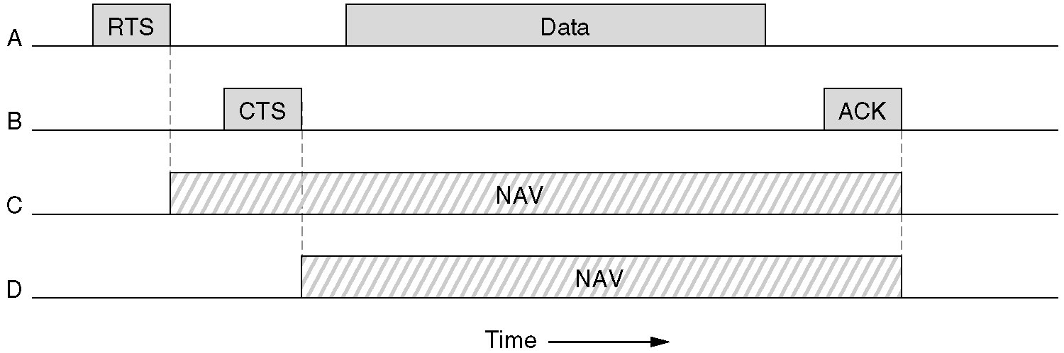
The 802.11 MAC Protocol (Cont)
DCF- 1b. Virtual Carrier Sense (VCS)
NAV-Network Allocation Vector -keeps other stations silent

Slide 19
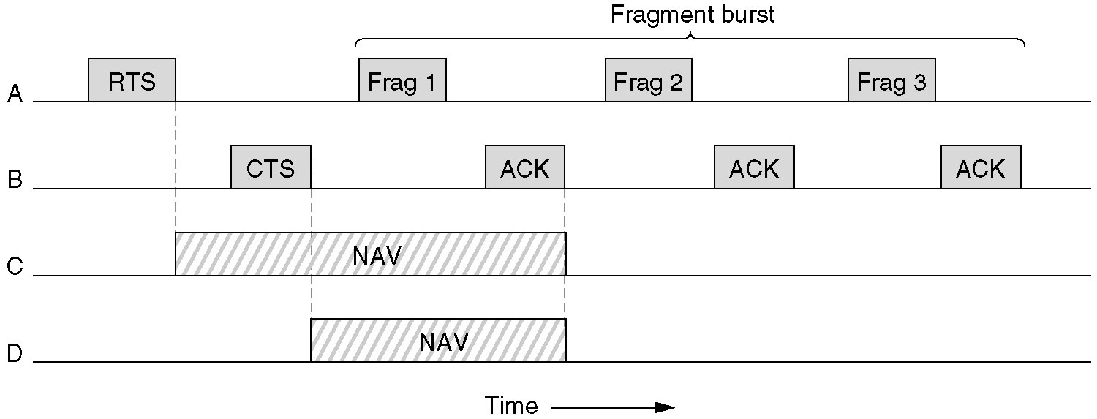
The 802.11 MAC Protocol (Cont) : fragments
1b. DCF-The use of virtual channel sensing using CSMA/CA.
stop-and-wait protocol

Slide 20
802.11 - CSMA/CA (cont)
1b. Virtual Channel Sensing
  It works by carefully defined the interframe time interval
  After waiting for DIFS-(DCF Inter Frame Spacing) sends RTS
  after SIFS (Short IFS) sends CTS as a ACK by if ready to receive
  Sender can now send data at once, ACK via CTS
  Medium reservations for other stations announced by RTS/CTS
  Network Allocation Vector- for silent stations
DIFS
RTS
data
sender
SIFS
SIFS
SIFS
CTS
ACK
receiver
NAV (RTS)
DIFS
other
stations
data
NAV (CTS)
defer access
contention
t

Slide 21
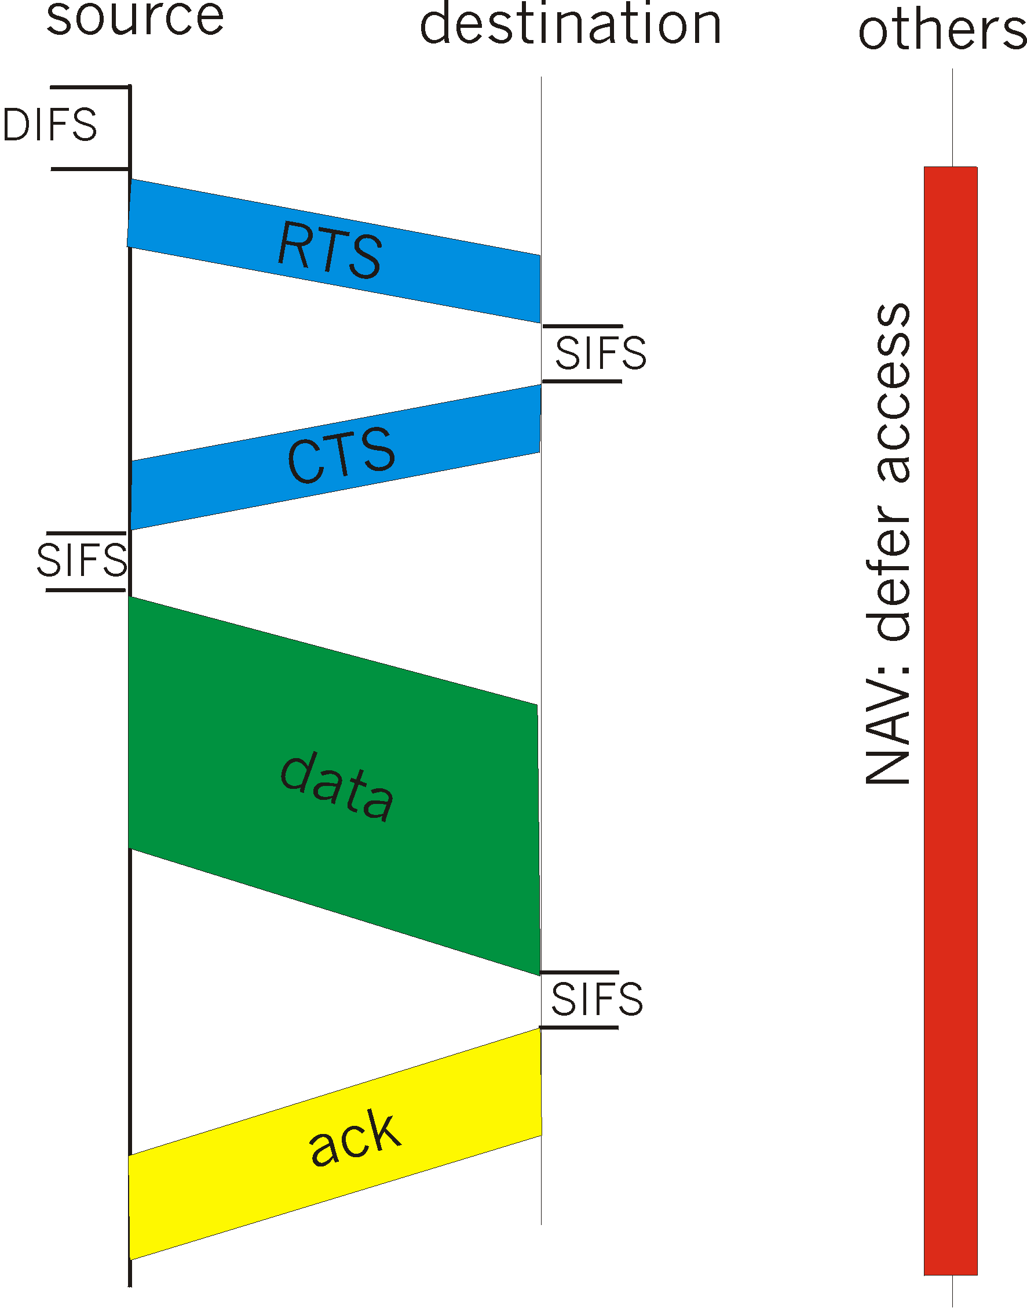
1b. CSMA/CA (cont)
CTS “freezes” stations within range of receiver (but possibly hidden from transmitter); this prevents collisions by hidden (from transmitter) station during data.

Slide 22
1b. 802.11 - MAC layer (cont)
Priorities
  Defined through different inter frame spaces
  SIFS (Short Inter Frame Spacing) single dialog the chance to go first
    Highest priority, for ACK, CTS, polling response
  PIFS (Point Coordination Function IFS) station sending a data frame or fragment sequence to finish its frame without anyone else getting in the way
    Medium priority, for time-bounded service using PCF
  DIFS (Distributed Coordination Function IFS) other stations requesting the medium
    Lowest priority, for asynchronous data service
    EIFS (Extended IFS) to report the bad frame
DIFS
EIFS
PIFS
medium busy
SIFS
contention
next frame
t
direct access if
medium is free ≥ DIFS

Slide 23
2 -Point Coordination Function
BS polls MSs, asking stations to send. no collision.
Base mechanism –
BS broadcasts a beacon frame (10 to 100 times per second). The beacon frame contains system parameters, such as hopping sequences and dwell times, clock synchronization, etc. (for FHSS),
It also invites new stations to sign up for polling service.
802.11 power management -BS can direct a MS to go into sleep state until awakened by the BS or the user. In this time the BS has the responsibility for buffering any frames directed at it while the MS is asleep.
PCF and DCF can coexist within one cell.

Slide 24
Full process steps:
1. A station that wants to transmit will first sense the medium. If the medium is idle, waits for a specified time-Distributed Inter Frame Space, or DIFS). If no other station transmits, then the station will transmit a short RTS packet. (Includes the source address, destination address, and duration of the following transmission). The duration = the total transmission time for all further packets that will be transmitted (CTS, data, ACK, plus inter‑frame spaces).
2. The Access Point responds with a response control packet called CTS, which includes the same duration information. Receipt of the CTS packet indicates to the transmitter that no collision occurred, and permission is granted to start the data transmission. If the transmitter does not receive a CTS packet, then it repeats part 1 until it either receives ACK or times out after a given number of re-transmissions.
Notes:
Binary backoff

Slide 25
3 The CTS frame is received by all the stations in the cell, notifying them that another unit will transmit during the following X microseconds. These stations record this information so they will know when the medium will again be available. Some of these stations may not have received the RTS packet because the original transmitting unit is out of range.
4. The transmitting station sends its data frame to the access point. After the data frame is transmitted, the access point checks the CRC of the packet end, if correct, returns an ACK packet to confirm successful transmission.
5. If the final destination is another station on the WLAN, the access point then reserves the medium with a RTS packet (step 1). It proceeds to retransmit the data frame. The destination station checks the CRC of the packet end, if correct, returns an ACK to the access point

Slide 26
Because the RTS and CTS are very short packets, this mechanism also reduces the overhead of collisions.
If the data packet is very short, the RTS packet may include all the data to be transmitted. If the RTS contains data, the CTS packet contains a duration of zero, and simply acts as an ACK to the transmitter that the RTS packet with data was received.
Typical WLAN protocols use packets several hundred bytes long
(up to 1518 bytes). These packets << than Ethernet packets. It is preferable to use smaller packets in a wireless environment for several reasons:
1. Due to the higher BER of a radio link, the probability of a packet getting corrupted increases with the packet size.
2. In the case of packet corruption (due to collision or noise), a smaller the packet requires less overhead if it is necessary to re-transmit.

Slide 27
Voice support in IEEE 802.11
DCF mode, with CSMA
voice has priority over data (Short IFS)
positive ACK guarantees success (no hidden terminal)
Possible Improvement:
instead of positive ACK, negative ACK
receiver "invites" the sender with negative ACK if did not receive packet after time out

Slide 28
The 802.11 standard specifies transmission techniques allowed in the physical layer
1. Use short-range radio, techniques of FHSS 79 hops, 1 MHz wide, PN seq., Dwell time 400 msec,
2. Use short-range radio DSSS. 1-2 Mbps, similar to CDMA.
Modifications: 802.11a--54 Mbps;
802.11b--11 Mbps;
802.11g--54 Mbps ??
Both of FHSS and DSSS use a part of the unlicensed spectrum (2.4 GHz) ISM (Industrial, Scientific, and Medical) application band.
Notes:
That’s why Cellular phones are not allowed in a Hospitals

Slide 29
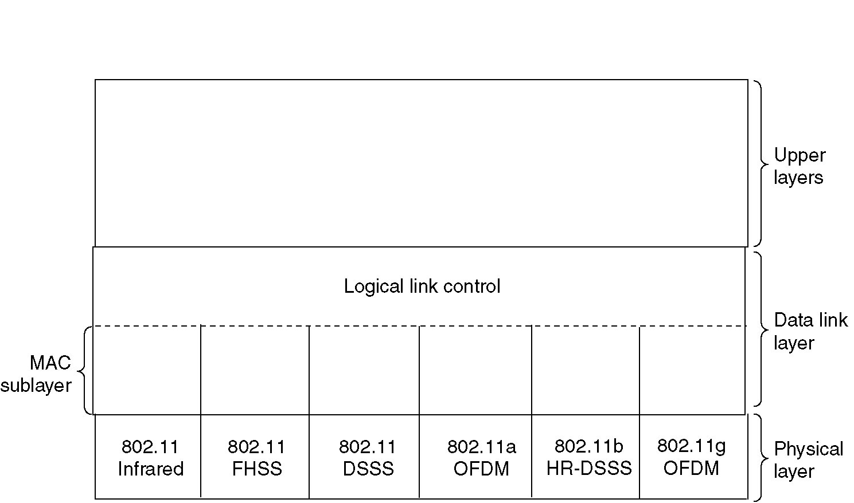
The 802.11 Protocol Stack
LLC sublayer, hides the differences between the different 802 variants and make them indistinguishable for the network .
The MAC sublayer determines how the channel is allocated, who gets to transmit next.
DLL
LLCMAC
High rate 11Mb
High rate 54Mb
operate at 1 to 2 Mbps,
Orthogona54Mb
Notes:
3 Physical layer Transmission techniques: 1 Infrared, 2 FHSS, 3. DSSS, using Indust. Scint, Medical band

Slide 30
802.11 Modifications
11 | 1 Mbps or 2 Mbps, so was too slow.
11a | FHSS; 5-GHz band; 54 Mbps; OFDM (48 data+4 Sync) ch. 18-54 Mbps, =With Europ. HiperLAN/2
11b | DSSS; Uses the same frequency band as 802.11, but uses different modulation technique achieve 11 Mbps.
11g | Uses the OFDM modulation= of 802.11a but the frequency band =of 802.11b. (Theory-54 Mbps)??

Slide 31
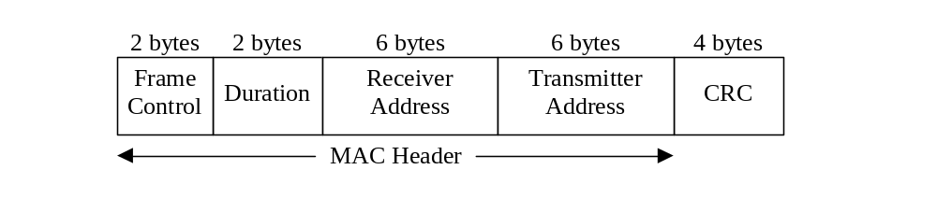
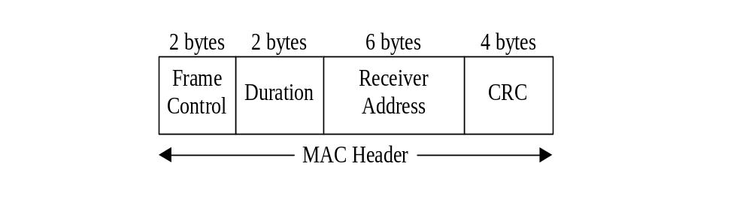
802.11 Frame Structure: Frames Classes
1. Data frame.
2. Control frame= RTS, CTS, ACK
RTS
CTS
ACK
3. Management
Exchange management information and are transmitted in the same manner as data frames, but are not forwarded to upper layer.
These frames are used for synchronization, authentication, and power management.

Slide 32

comparison of the four basic multiple access versions
Apprch | SDMA | TDMA | FDMA | CDMA
Idea | Segment space in cells/sectors | Segment sending time in disjoint slots, | Segments the frequency band | Spread the spectrum using orthogonal codes
Terminals | one terminal can be active in one cell | terminals are active for short time on the same frequency | Every terminal has its own frequency, uninterrupted | All terminals can be active at the same place at the same moment,
Signal separation | Cell structure directed anten | Synchronization in the time domain | Filtering in the frequency domain | Code plus special receivers
Advant- ages |  | Established, fully digital, flexible | Simple, established, robust | Simple, less planning needed, soft handover
Disadvan-tages | Inflexible, antennas typically fixed | Guard space needed (multi-path propagation difficult | Inflexible, frequencies are a scarce resource | Complex receivers, needs more complicated power control for sender
Comment | Only in combination with TDMA, FDMA or CDMA useful | Standard in fixed networks, together with FDMA/SDMA used in many mobile networks | Typically combined with TDMA (frequency hopping patterns) and SDMA frequency reuse | Used in many 3G systems, higher complexity, lower expectations; integrated with TDMA/FDMA

Slide 33
CSMA/CA Protocol: Congestion control
Networks with wireless and other lossy links suffer from significant losses from congestion, due to interference, fading, multipath effects, and other wireless medium characteristics.
TCP responds to all such losses, by invoking congestion control and congestion avoidance algorithms,
TCP seeks to meet the following four primary goals:
1. Reliable transport,
2. High network utilization,
3. Avoidance of network congestion, and
4. Sharing of bandwidth

Slide 34
Congestion control (Cont)
TCP uses a sliding window mechanism-congestion window with cumulative ACKs to implement the above four goals:
1. In an ideal scenario without any other competing TCP flows, the TCP sender sets congestion window that should equal to the total number of packets that can be pipelined between the sender and receiver.
2. The rate of the TCP sender is simply the size of this window over the total RTT: Source rate = window size / RTT
2a.Thus, can be used to approximate the size of the ideal congestion window: Window size = bandwidth x RTT
2b.In reality a given TCP flow can never know the actual bandwidth of the network, the TCP source must somehow share the network with other competing flows. As a result, TCP employs a set of congestion control algorithms to attempt to set the window size over time

Slide 35
Congestion control (Cont)
3. Traditional TCP congestion control (TCP Reno) has four key phases:
Slow Start (SS),
Congestion Avoidance (CA),
Fast Retransmit (FT), and
Fast Recovery (FR).
In addition to have a varying Contention Window (CWIN), TCP also employs a value called the “Slow Start Threshold” (SSTresh) to decide between SS and CA phases.
4. A TCP sender initially begins in the SS phase, which begins with CWIN set to 1. On each successful ACK, we increment our CWIN by 1. Thus, this results in the exponential growth of the CWIN because in each RTT, CWIN = 2 * CWIN. When the CWIN finally exceeds SSTresh, TCP enters the CA phase

Slide 36
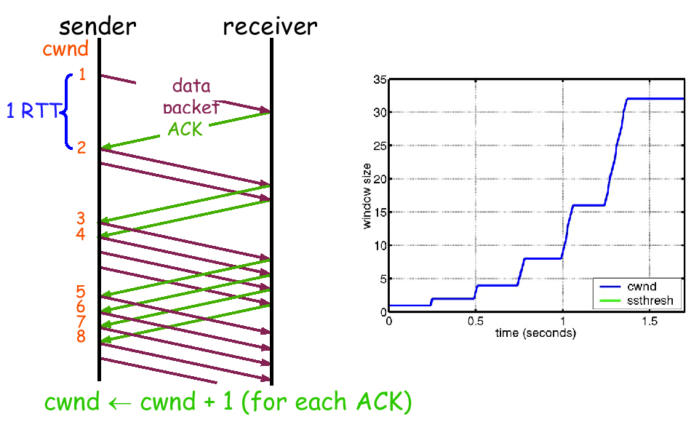
Congestion control (Cont)
In each RTT, CWIN = 2 x CWIN.
32
SStresh
RTT

Slide 37
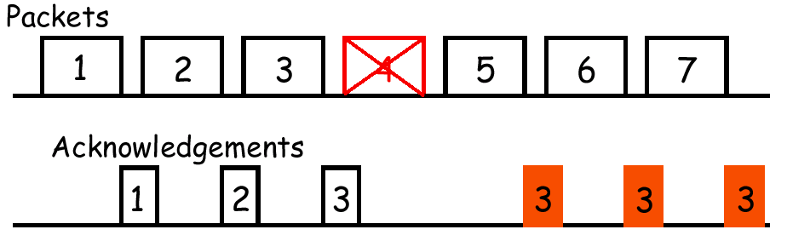
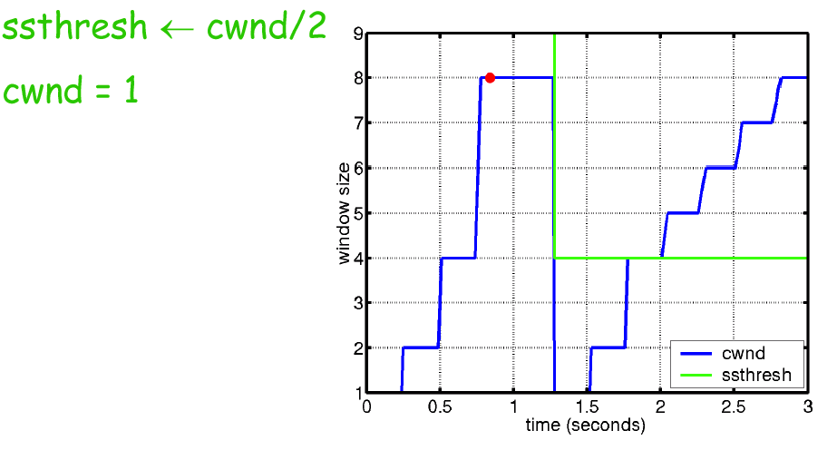
Congestion control (Cont)
packet loss: (a) timeout,
(b) duplicate ACK
SS SSTresh CA
TCP assumes that the packet loss is due to network congestion, TCP sets the SSTresh to half the current CWIN, and the CWIN back to 1 and re-enters the SS phase

Slide 38
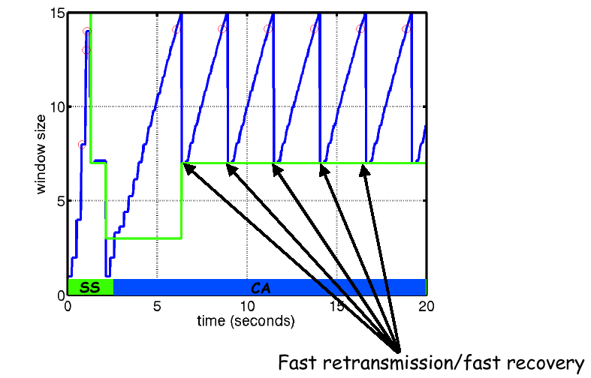
Congestion control (Cont)

Slide 39
The Internet has two main protocols in the transport layer:
Connectionless protocol (User Datagram Protocol- UDP).
Connection-oriented (Transport Control Protocol- TCP).

Slide 40
a. User Datagram Protocol. Because UDP is basically just IP with a short header added. Applications of UDP. The IP supports is connectionless transport protocol, UDP sends datagram without having to establish a connection.
b. Transport Control Protocol provides a reliable end-to- end byte stream over an unreliable internetwork.
TCP provides multiplexing, demultiplexing, and error detection in exactly the same manner as UDP. Nevertheless, TCP and UDP differ in many ways. The most fundamental difference is that: UDP is connectionless, while TCP is connection-oriented.

Slide 41
BH 3424
Boelter Hall
3rd Floor
c
Elevator
90 ft
BH 3428
b
BH 3704
EE 171L Lab
Entry
60ft
a
30 ft

Slide 42
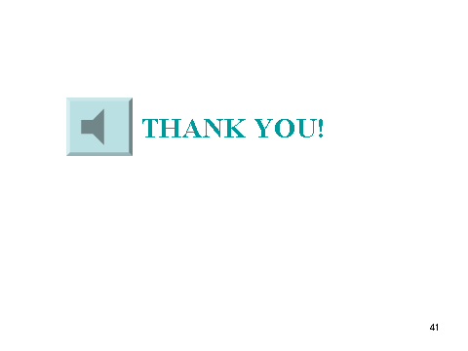

Slide 43
APPENDIX
The 802.11 Services
Each wireless LAN must provide nine services divided into two categories:
1. Five distribution services (provided by BS) and
2. Four station services (provided by MS).
Distribution services relate to managing cell membership and interacting with stations outside the cell.
Station services relate to activity within a single cell.

Slide 44
802.11 Services
Distribution Services (BS) deal with station mobility as they enter and leave cells, attaching themselves to BS and detaching themselves from BS. They are as follows:
Association
Disassociation
Re-association
Distribution
Integration

Slide 45
Distribution services (BS Services (Cont))
1. Association. Used by MS to connect themselves to BS. It is used just after a MS moves within the radio range of the BS. Upon arrival, it announces its identity and capabilities. The capability include the data rates supported, need for PCF services and power management requirements. The BS may accept or reject the MS. If the MS is accepted, it must then authenticate itself.
2. Disassociation. The MS or the BS may disassociate, thus, breaking the relationship. A MS should use this service before shutting down or leaving, but the BS may also use it before going down for maintenance.
3. Re-association. A MS may change its preferred BS using this service. This facility is useful for MS moving from one cell to another.
4. Distribution. Determines how to route frames sent to the BS. If the destination is local to the BS, the frame can be sent out directly over the air. Otherwise, they will have to be forwarded over the wired network.
5. Integration. Handles the translations from the 802.11 format to the format required by the destination network.

Slide 46
802.11 Station Services
Intra-cell Services, by MS
Authentication
De-authentication
Privacy
Data Delivery

Slide 47
Intra-cell Services (Cont) (MS services)
1. Authentication. Because wireless connection can easily used by unauthorized stations, a MS must authenticate itself before it is permitted to send or receive data. MS must know the secret password.
2. De-authentication. When a previously authenticated station wants to leave the network, it is de-authenticated.
3. Privacy. For information sent over a wireless LAN to be kept confidential, it must be encrypted. This service manages the encryption and description.
4. Data delivery. 802.11 naturally provides a way to transmit and receive data. Since 802.11 is modeled on Ethernet and transmission over Ethernet is not guaranteed to be 100% reliable, transmission over 802.11 is not guaranteed to be reliable either. An 802.11 cell has some parameters that can be inspected and, in some cases, adjusted. They relate to encryption, timeout intervals, data rates, beacon frequency, and so on.

Slide 48
TCP Slow Start for reliable comm.
44
40
36
32
28
24
20
16
12
8
4
Congestion window (kilobytes)
congestion-avoidance
Timeout
Threshold
Thr/2
Threshold
Jacobson’s slow start algorithm
Slow start
Threshold
0 2 4 6 8 10 12 14 16 18 20 22 24
Transmission number

Slide 49
Congestion Control
Since the number of nodes attempting to transmit simultaneously may change with time, some mechanism to manage congestion is needed
IEEE 802.11 DCF: Congestion control achieved by dynamically adjusting the contention window cw

Slide 50
Binary Exponential Backoff in DCF
When a node fails to receive CTS in response to its RTS, it increases the contention window, it is doubled (up to an upper bound – typically 5 times)
When a node successfully completes a data transfer, it restores cw to CWmin
Contention:
1. A condition that arises when two or more data stations attempt to transmit at the same time over a shared channel.
2. Competition by users of a system for use of the same facility at the same time.

Slide 51
IEEE 802.1 DCF Congestion Avoidance
Before transmitting a packet, randomly choose a backoff interval in the range [0, cont.wind].
Count down the backoff interval if medium is idle: Count-down is stopped if medium becomes busy.
When backoff interval reaches 0, transmit packet.
Choosing a large cw (contention window) leads to large backoff intervals and can result in larger overhead
Choosing a small cw leads to a larger number of collisions (more likely that two nodes count down to 0 simultaneously)

